Slide 1
XOR Media CloudAqua
Cloud Storage Optimized for Media Operations
Notes:
Updated on 2014/7/16
Version: 002

Slide 2















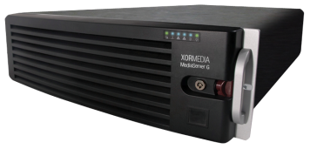
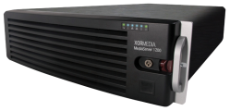










XOR Media Architecture
Production/MAM
Data source for graphic templates
Play to Air (SD/HD)
AVID
FCP
DALET
ADOBE
PREMIERE
XOR Artist
Database
file
internet
FTP
SMB2
iSCSI
Dynamic
data
Cloud Browser
Journalist
Videos / Images
HTTP
SDI
CloudAqua
Channel in Box
LAN/WAN
Integrated Channel Playout with Branding
SMB2
Video clips
/templates
Ingest
IPTV
Automation
API/VDCP
Playlist Preload
API/VDCP
XOR Media
Controller Tool
Cloud Aqua
Media Server C
Traffic System
3rd Party
Automation
3rd Party
Traffic System
Media Server G
IP Stream
CDN
Baseband
Live
feed
Studio
Outside
Broadcast
Live
3rd party Cloud

Slide 3
CloudAqua
Private cloud storage accessible across corporate and public networks including geographically dispersed locations providing a massively scalable global storage pool
Object-based storage, optimized for media files, providing intelligent management
On-demand allocation of storage and network resources improving storage provisioning, utilization and efficiency
Real-time data sharing and application transparency through open standard interfaces
Software Defined Storage (SDS)
Notes:
3

Slide 4


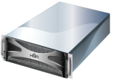


Scalable Global Storage Pool
Multi-tenancy
Efficient storage resources allocation
Improves storage utilization and efficiency through on-demand allocation of storage and network resources
Heterogeneous
Integrates heterogeneous storage devices:
  Universal MediaLibrary series (UML-T, UML-E, UML-N16, UML-N70) of high density storage
  3rd party storage devices
  3rd party cloud – Amazon, etc.
CloudAqua

Slide 5


Object-based Storage
Object = Media File + Metadata (system & user-defined)
Metadata Centric
  Distributed NoSQL database, by-passing local file system attributes
  High volume, dynamically growing
  Define, tag, search and share across applications
Single file
no segmentation for performance and fault resilience
Stored in a flat structure
simplifies management and searching
Transparent to external applications
Objects are managed across all sites and regions. External applications access objects in the cloud object store transparently.
OBJECT
MEDIA FILE
SYSTEM METADATA
USER-DEFINED METADATA
CloudAqua

Slide 6
Distributed Infrastructure
Completely distributed and loosely coupled
  Distributed structure for various engines (policy, metadata, etc.)
  Handle massively parallel operations on big data distributed geographically
  Distributed metadata database
  No central file-system metadata controllers
  No requirements on co-locations
Easy to start small and scale out
  Low cost of entry as system will scale from a single node to a large multi-site infrastructure

Slide 7
Rich, Open Interface and Tools
Support for Cloud Industry Standard Interfaces
  CDMI (Industry standard RESTful programmatic interface)
  Amazon S3
NAS: NFS, CIFS / SMB2, FTP, etc.
  Simplifies legacy application integration with CloudAqua
  Support of throughput tuning and transparent cloud-scaling
Various SDK package interfaces (java, dotnet, phython, C/C++, android, ios, javascript) and plug-ins of mainstream OS
Net Disk
  Object explorer for CloudAqua provides a web-based client tool that a user can use to explore, access andmanage objects and containers stored in CloudAqua

Slide 8
Software defined storage
Provide enriched functionalities across a wide range of server hardware components. such as:
  Deduplication
  Replication
  Thin provisioning
  Snapshots, and
  other backup and restore capabilities
The pooled storage resources be automatically and efficiently allocated to match the application needs
Increased flexibility, automated management and cost efficiency

Slide 9





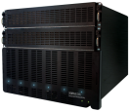
Next generation Object-based Storage Architecture
Application(s)
Applications gain universal access to Global big-data and CDN storage repository
AssetFlow
RS-DVR
Back Office
Object-based
Storage APIs
RESTful API – Based on open standards
Linux OS Plug-in
NFS / SAMBA / FTP
phython
java
c/c++
Data
Management
Content Processing
Quota Management
Policy Engine
Access Management
Offload storage functions from application(s)
Data Replication
Version Control
Metadata Engine
Snapshot Management
Storage
Management
High Availability
Storage Virtualization
Data Security
High Speed I/O
SAN/NAS
Physical
Storage (UML)

Slide 10
Availability and Resiliency
Operational Integrity
  Access Control List (ACL) at object and container levels
  Authentication via integration with LDAP or Active Directory
  Integrates with existing IT security infrastructure
Built-in Disaster recovery
  Multiple data replications across geographic locations/networks
  Application service redundancy over LAN/WAN
  Region failover and failback
Soft-RAID for data protection and high I/O throughput
  Read-ahead
  Write-back-cache
  Merger

Slide 11









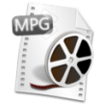


CloudAqua for Media Production
Heterogeneous storage hardware
CIFS SMB2 iSCSI performance tuning for Adobe, FCP, etc.
Integrated media processing modules
Collaborate across organizations and disperse locations
  Extend a single MAM system across multiple locations
Intelligent management of asset lifecycle
Increased reliability and scale
Non Linear Editing & Media Processing
FCP
ADOBE
PREMIERE
Transcoding
QA
Water
marking
facial
recognition
SMB2
FTP
iSCSI
Site 2
Site 1
Site 3
Play-to-air
File upload/update
Media Processing
Notes:
Heterogeneous storage hardware
Integrated media processing modules such as transcoding, QA, watermarking, facial recognition, etc.
SMB2 connectivity and performance tuning with Adobe, FCP, etc.
Collaborate across locations/networks
Extend a single MAM system across multiple geographic locations
Intelligent management of asset lifecycle
Auto delete files, schedule archive/restore upon status or metadata change as well as other policies
High stability
Integrated with XOR’s MSV-C video ingest server to support seamless failover of an ingest session, masking network or storage error without interrupting ingest session
On the previous slide it describes automatic content cache based on playlist. Where is
this playlist coming from? It also refers to integrating with traffic systems. The playlist
Will come from automation based on data it receives from traffic. Automation is
normally the application that requests the server’s inventory and compares it to its
Playlist to ensure all files will be ready to play at their required times. If files are absent
Some automation has the capability to request file movement from archive to the server’s
storage. From the presentation it sounds like Cloud Aqua is doing this function. Does
Cloud aqua get a copy of the playlist to determine what needs to be moved from
Near-line to the play-out server? Zheng has mentioned a Playlist pre-load. Is this what
Cloud Aqua is accessing to determine what needs to be moved? What automation
Companies support our playlist pre-load app?
Ara>>As a workflow system, traffic system is capable to manage the overall playout workflow, including playlist generating/importing (by scheduling module in the system), clip preparation, content caching, etc. It is the traffic system, who ensures the clips are on the proper storages, determines what needs to be moved and executes the caching action. Automation system in this case, only does the playout control. Playlist pre-load is only for playback purpose, I don’t think it is related to clip preparation.
Also need more information on how the fault tolerant play-out works for the MSV-C&G
UML. Are we saying if a UML nodes fails the MSV will automatically reconnect to
another storage node? How does this work? Also need more background
On the mini-playout cloud architecture, features and cost saving benefits.
Ara>>The fault tolerant play out is based on CloudAqua’s feature. Since cloud storage is transparent to application, a storage node failure will not affect the playout. CloudAqua will re-direct to the clip on other storage.

Slide 12
Policy-Driven Intelligent Media Management
Based on pre-defined policies, actions can be taken automatically upon metadata change to the object
The execution of policies can trigger:
  Creation and caching of data file replica(s) in the appointed region(s) or storage clusters
  Processing of data file, such as transcode, compression, sniffing, dedupe and checksum
  Migration of data file
  For example, upon upload or update of a media file, the file can automatically be replicated to other regions or transcoded.
Open interfaces (such as RESTful APIs) are available to 3rd party media processing tools, enabling extensive data processing capability

Slide 13
Queue Mechanism
A sample queue procedure works as below:
  1. 2. Application A uploads object to CloudAqua and creates a task queue in CloudAqua
  Application B listens to the queues and gets task
  4.5. Application B conducts media processing and feedback status to queues; the object metadata can also be added/updated according to needs
  6. Once the processing is done, Application B feedback the “done” status to the queue
Benefits
  Simplifies applications collaborations
  Manages/updates object metadata in storage level with less complexity and more flexibility
APP A
1
2
New task
OBJECT (ver.0)
FILE
METADATA
New task
media
processing
New task
4
CloudAqua
In process
In process
5
In process
OBJECT (ver.1)
processed
processed
3
FILE
METADATA
In process
6
New task
processed
APP B

Slide 14
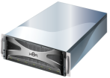




CloudAqua for Media Delivery
Production Cloud
Automated contents management based on playlist
  Integrates with automation or traffic systems
  Automated contents migration from near-line to online storage
  Deletes contents from PTA storage based on playlist.
Playout cloud with richer features and lower cost
  Provides N+1 scalability, robust content availability, and cost effective solution
Metadata
Control
Content
migration
CloudAqua
Playout
Cloud
Automation/
Traffic System
Stream
through
Stream
through
MSV-G
MSV-C
Play to Air (SD/HD)
Mini Playout cloud

Slide 15



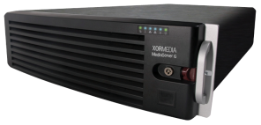
Simplified workflow for live contents
Contents
Procedures of a simplified broadcasting workflow
  Contents upload to CloudAqua
  Contents replica generated on both production cloud and playout cloud
  Stream from playout cloud
Benefits
  Lower Latency for live contents, such as news, sports events
  Less complexity
Production
Cloud
1
2
replica
Playout
Cloud
CloudAqua
2
replica
3
Video Server
MSV-G/ MSV-C

Slide 16

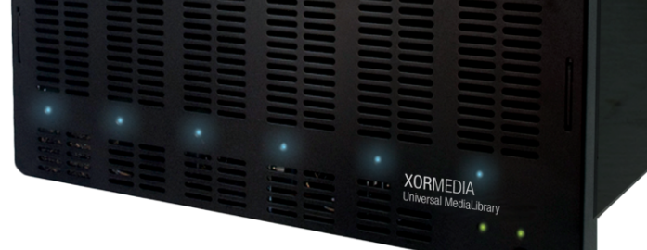

Thank you!
Notes:
16

